Slide 1
Sprint 4 Planning
CB06 - group 4
Emanuil Karapachov
Bojidar Balabanov
Vlad Cojocariu
Mila Marinova
Wondimu Woldeaarggiye

Slide 2
Agenda
Better structure around the code
Dashboard Functionality
Patient Page finishing touches

Slide 3
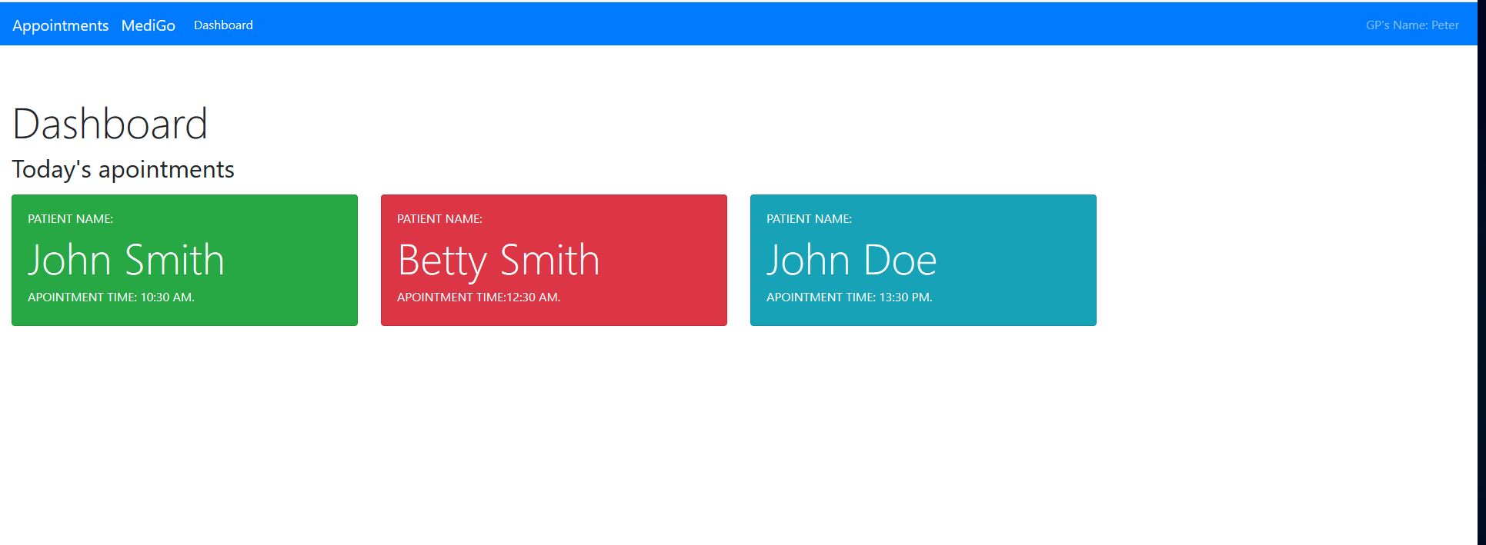
Dashboard
Add Calendar-like functionality
Pull data from the database about the patient appointments
(Optional) Add extensive styling to the page

Slide 4
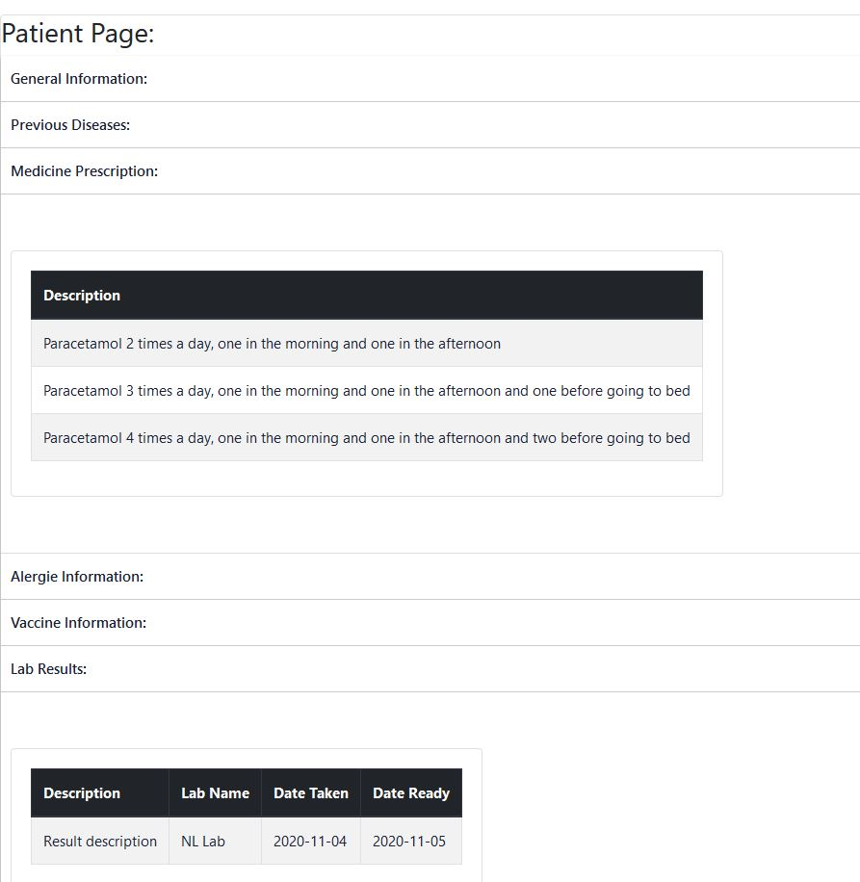
Patient Page
Add general information tab
Route properly the data from the database with their given patient.
(Optional) Add extensive styling to the page

